Slide 1


Yevhenii Horbatiuk
06.07.2023

Slide 2

Outline
Executive Summary
Introduction
Methodology
Results
Conclusion
Appendix

Slide 3
Executive Summary
Summary of methodologies. During investigation using next step of methodologies: Data Collection, Data Preparation, Modelling and Evaluation.
Summary of all results. Finally, as a result have been discover some relationship and patterns in the data that relate to the landing of rocket. Also, was building prediction model which predicts the probability of the launch outcome.

Slide 4
Introduction
Project background and context. The background for the research was the experience of other companies involved in similar developments.
Problems you want to find answers. The main issues raised were:
How effective is this technology?
At what stages and under what conditions are they a hindrance?
What benefit was bring?
Explore patterns. What can be patterns?

Slide 5

Section 1

Slide 6
Methodology
Executive Summary
Data collection methodology:
API. Getting some base data from SpaceX API.
Web Scraping. Extract a Falcon 9 launch data from Wikipadia
Perform data wrangling
In this case, it will perform some Exploratory Data Analysis to find some patterns in the data and determine what would be the label for training supervised models.
Perform exploratory data analysis (EDA) using visualization and SQL
Perform interactive visual analytics using Folium and Plotly Dash
Perform predictive analysis using classification models
Creating pipline for data preparing and using SVM, Classification Trees and Logistic Regression with diff Hyperparameters to find best estimator, also it was evaluation by accuracy metric

Slide 7
Data Collection
2 way:
- API
- Web Scraping from Wikipedia

Slide 8
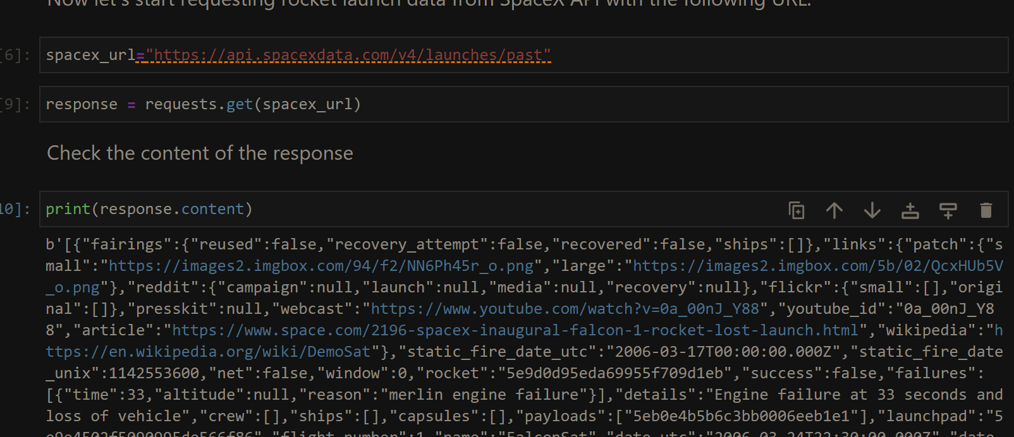
Data Collection – SpaceX API
Present your data collection with SpaceX REST calls using key phrases and flowcharts
Add the GitHub URL of the completed SpaceX API calls notebook (must include completed code cell and outcome cell), as an external reference and peer-review purpose

Slide 9
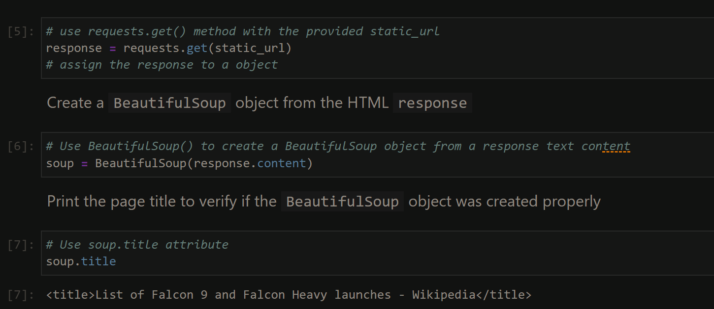
Data Collection - Scraping
Present your web scraping process using key phrases and flowcharts
Add the GitHub URL of the completed web scraping notebook, as an external reference and peer-review purpose
Place your flowchart of web scraping here

Slide 10
EDA with Data Visualization
Because they are easy to read and allow you to visually evaluate the data

Slide 11
Build an Interactive Map with Folium
Folium is a Python library that enables you to create interactive maps and visualizations. Here are several reasons why you might consider using Folium for data visualization:
Ease of Use: Folium is built on top of the popular mapping library Leaflet.js, but it provides a Pythonic interface, making it relatively easy to create interactive maps and visualizations even if you have limited experience with JavaScript.
Interactive Visualizations: Folium allows you to create interactive maps that can be zoomed, panned, and clicked on to reveal additional information. This interactivity enhances the user experience and enables you to present complex data in an engaging and intuitive way.
Rich Map Features: Folium supports various tilesets, including Mapbox, OpenStreetMap, and Stamen, allowing you to choose the map style that best suits your visualization needs. Additionally, you can overlay markers, polygons, and other shapes on the map to represent your data in a geospatial context.
Integration with Pandas: Folium seamlessly integrates with Pandas, a popular data manipulation library in Python. This integration enables you to easily visualize data from Pandas DataFrames on interactive maps, making it convenient for exploring geospatial patterns and relationships in your data.

Slide 12
Build a Dashboard with Plotly Dash
Plotly Dash is a Python library that enables you to build interactive web applications for data visualization. Here are several reasons why you might consider using Plotly Dash for data visualization:
Interactive and Real-Time Updates: Plotly Dash allows you to create interactive visualizations that respond to user inputs in real-time. This means you can build dynamic dashboards and applications where users can explore and interact with the data, such as filtering, selecting, and zooming in on specific data points or regions of interest.
Easy Integration of Plotly Graphs: Plotly Dash is built on top of the Plotly library, which is known for its powerful and aesthetically pleasing visualizations. With Plotly Dash, you can easily incorporate Plotly graphs, such as scatter plots, line charts, bar plots, and heatmaps, into your web application. This gives you access to a wide range of customizable and interactive visualization options.

Slide 13
Predictive Analysis (Classification)
Data preparing to ML, normalized.
For define best model was build diff model KNN, LogReg, Tree, SVM and evaluated by accuracy

Slide 14

Section 2

Slide 15
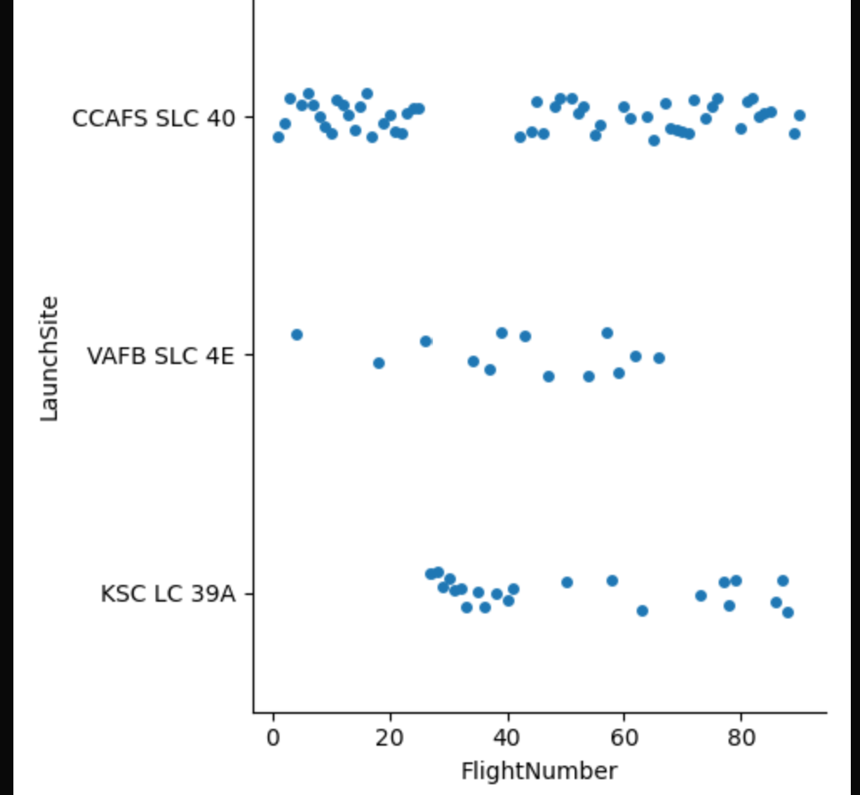
Flight Number vs. Launch Site
Show a scatter plot of Flight Number vs. Launch Site
Show the screenshot of the scatter plot with explanations

Slide 16
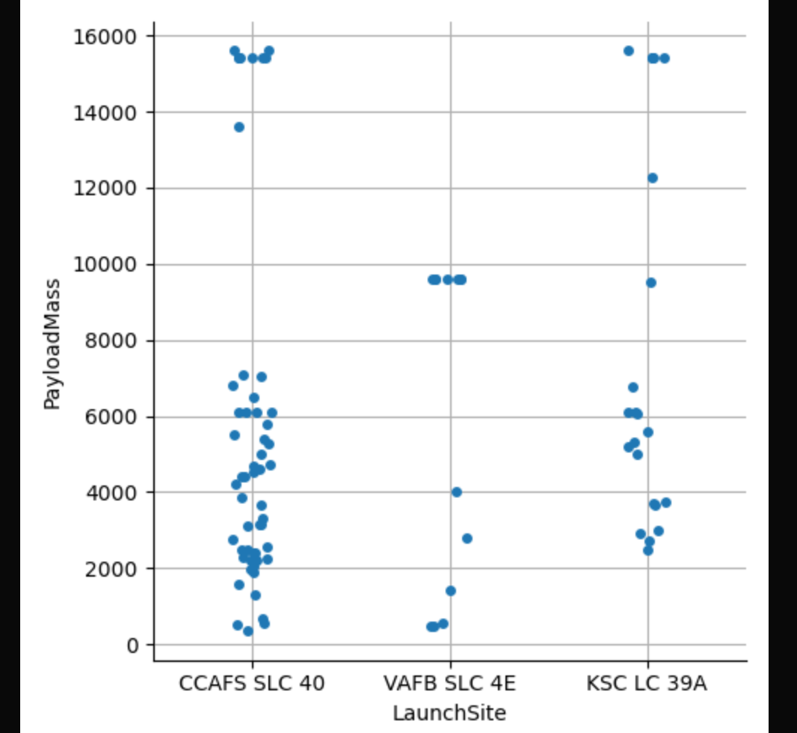
Payload vs. Launch Site
Show a scatter plot of Payload vs. Launch Site
Show the screenshot of the scatter plot with explanations

Slide 17
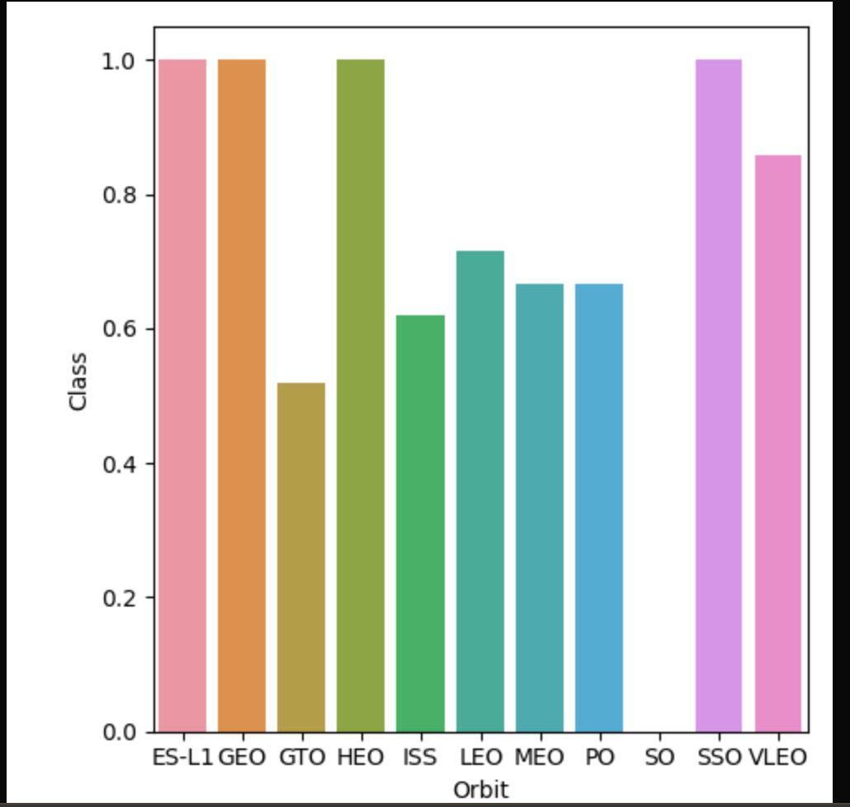
Success Rate vs. Orbit Type
Show a bar chart for the success rate of each orbit type
Show the screenshot of the scatter plot with explanations

Slide 18
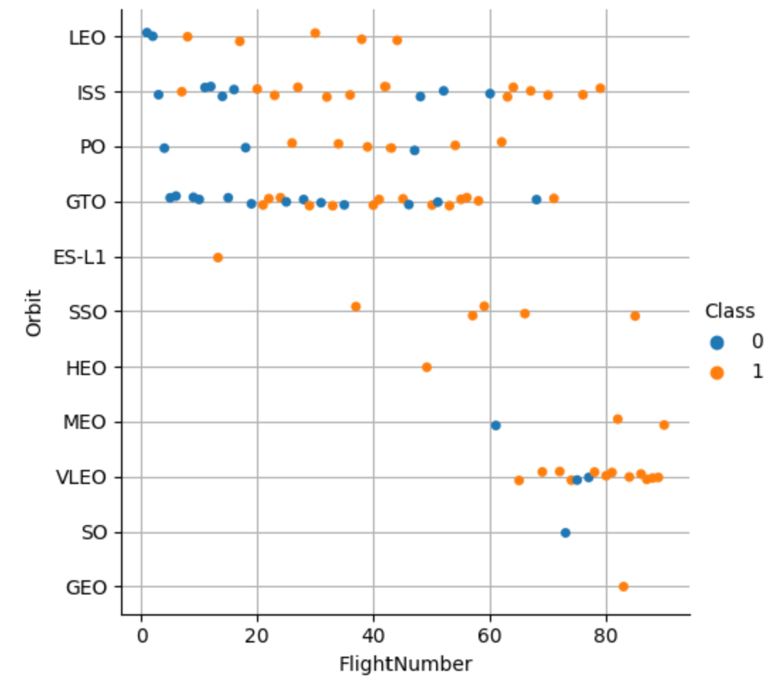
Flight Number vs. Orbit Type
Show a scatter point of Flight number vs. Orbit type
Show the screenshot of the scatter plot with explanations

Slide 19
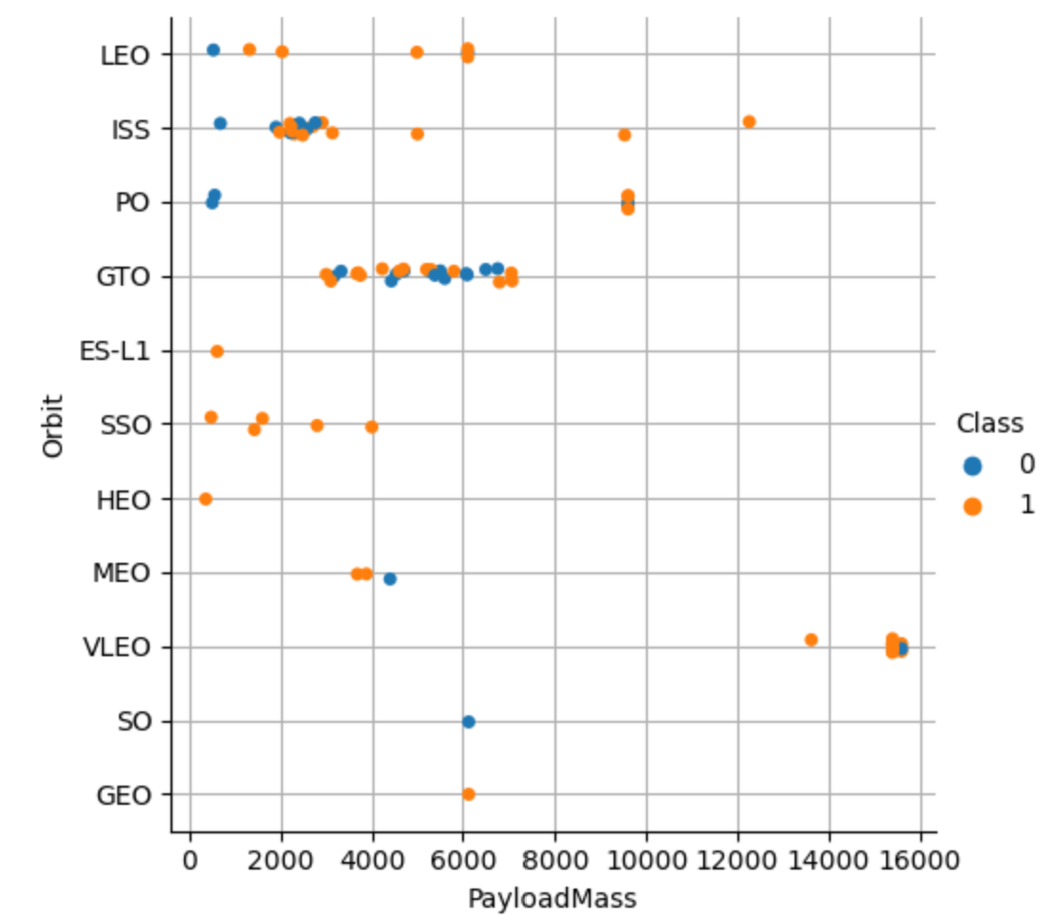
Payload vs. Orbit Type
Show a scatter point of payload vs. orbit type
Show the screenshot of the scatter plot with explanations

Slide 20
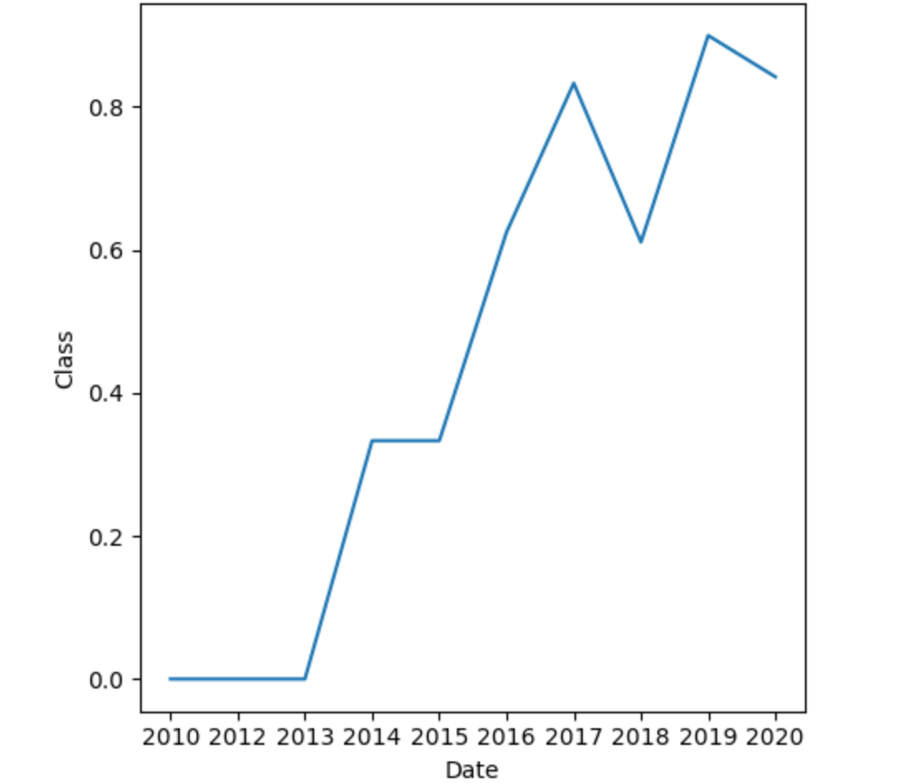
Launch Success Yearly Trend
Show a line chart of yearly average success rate
Show the screenshot of the scatter plot with explanations

Slide 21
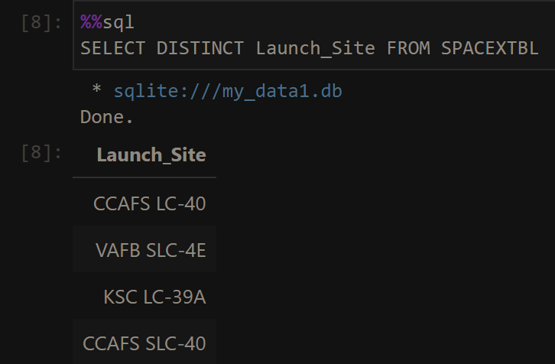
All Launch Site Names
Find the names of the unique launch sites
Present your query result with a short explanation here

Slide 22
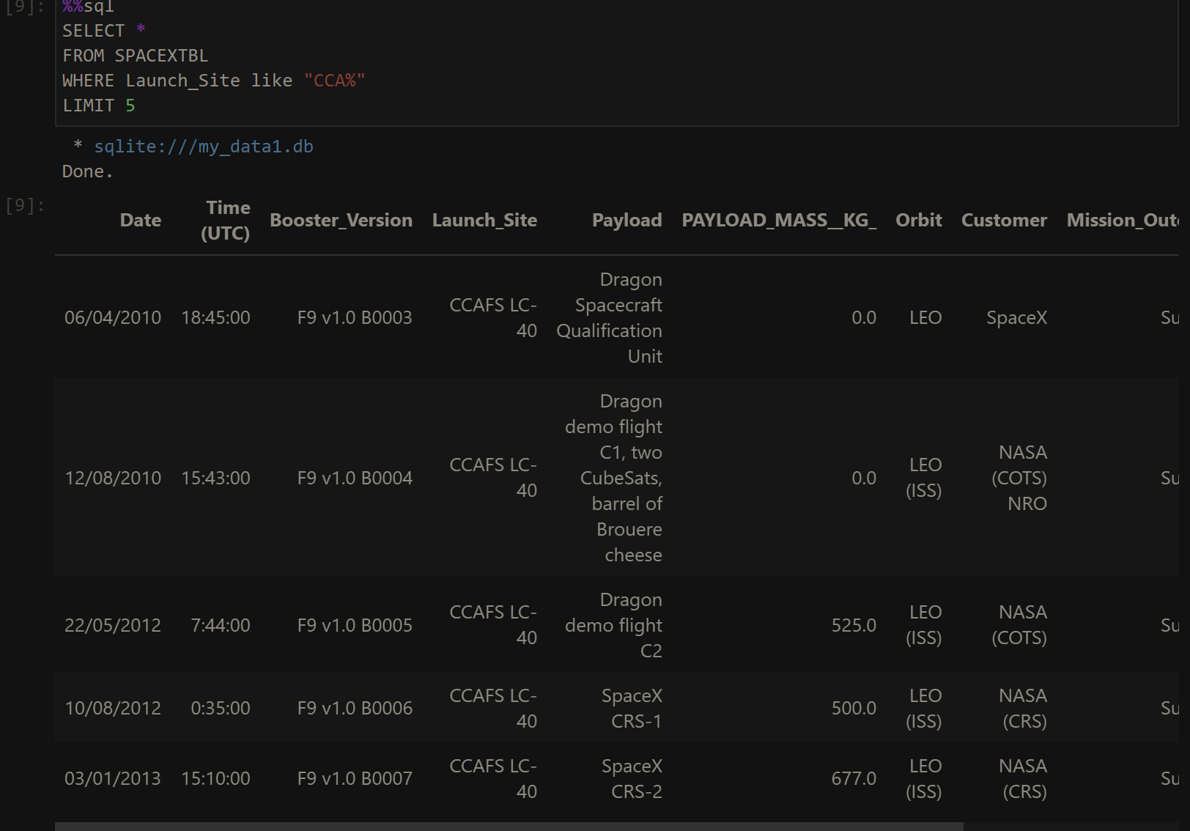
Launch Site Names Begin with 'CCA'
Find 5 records where launch sites begin with `CCA`
Present your query result with a short explanation here

Slide 23
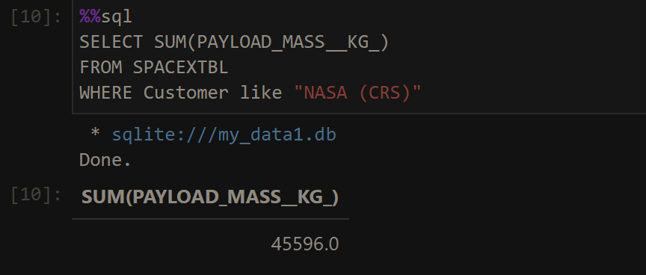
Total Payload Mass
Calculate the total payload carried by boosters from NASA
Present your query result with a short explanation here

Slide 24
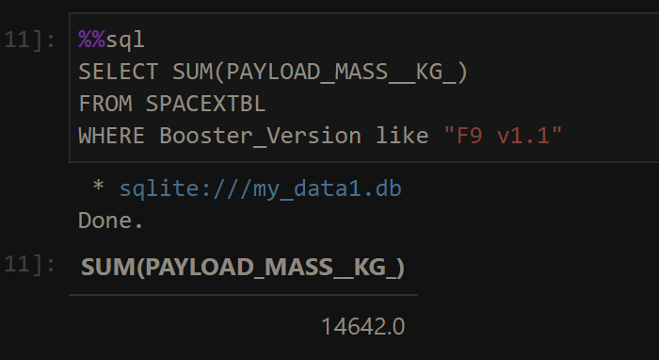
Average Payload Mass by F9 v1.1
Calculate the average payload mass carried by booster version F9 v1.1
Present your query result with a short explanation here

Slide 25
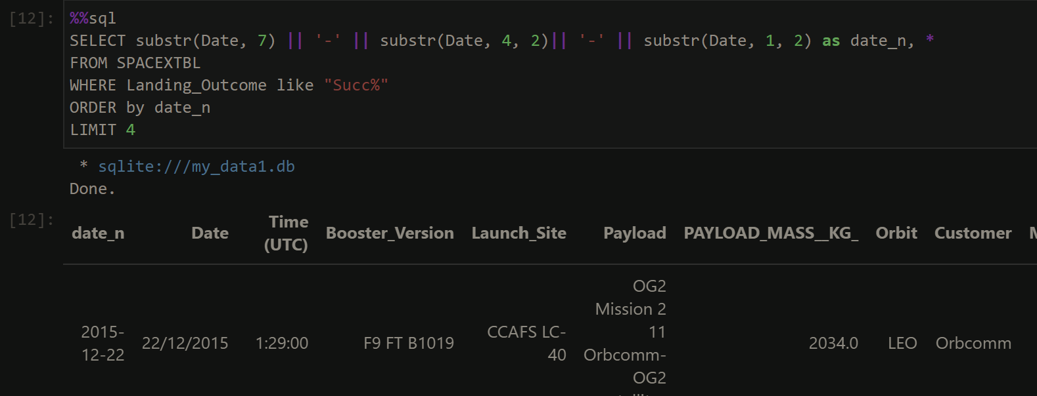
First Successful Ground Landing Date
Find the dates of the first successful landing outcome on ground pad
Present your query result with a short explanation here

Slide 26
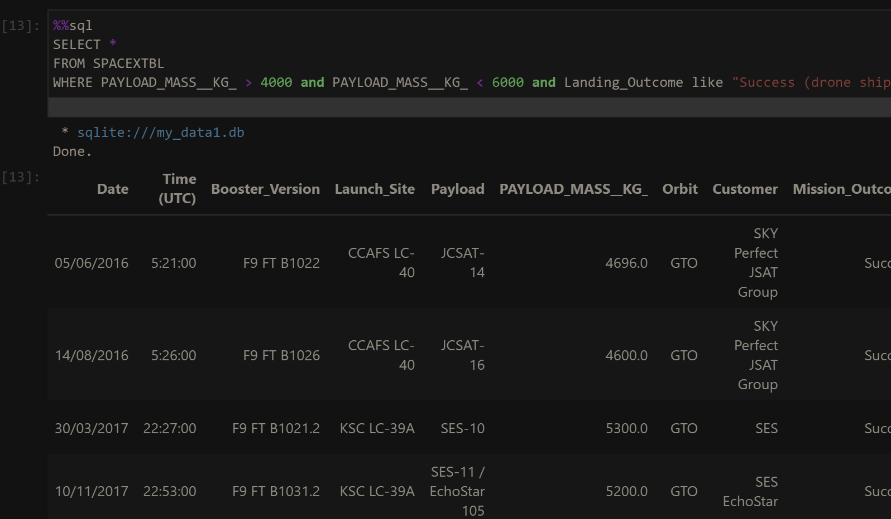
Successful Drone Ship Landing with Payload between 4000 and 6000
List the names of boosters which have successfully landed on drone ship and had payload mass greater than 4000 but less than 6000
Present your query result with a short explanation here

Slide 27
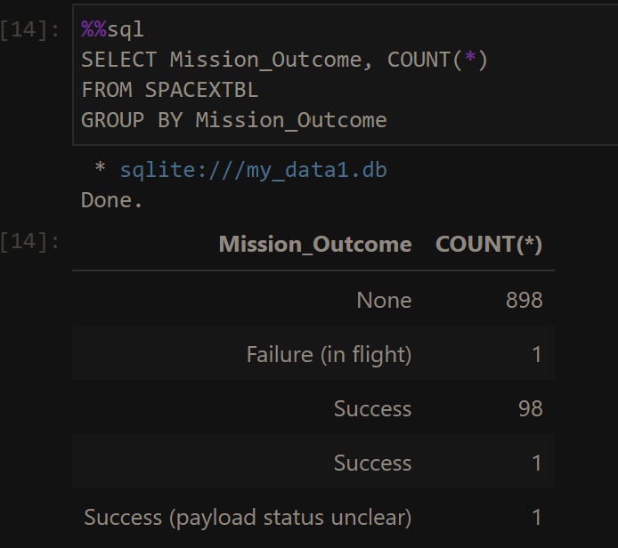
Total Number of Successful and Failure Mission Outcomes
Calculate the total number of successful and failure mission outcomes
P

Slide 28
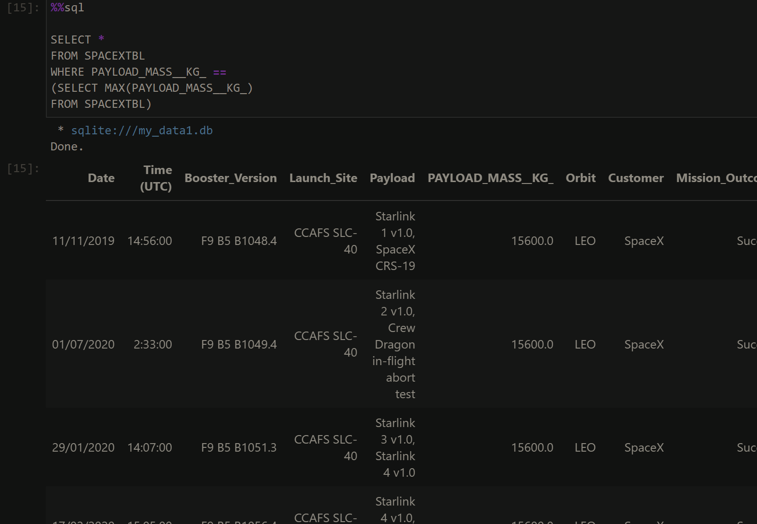
Boosters Carried Maximum Payload
List the names of the booster which have carried the maximum payload mass
Present your query result with a short explanation here

Slide 29
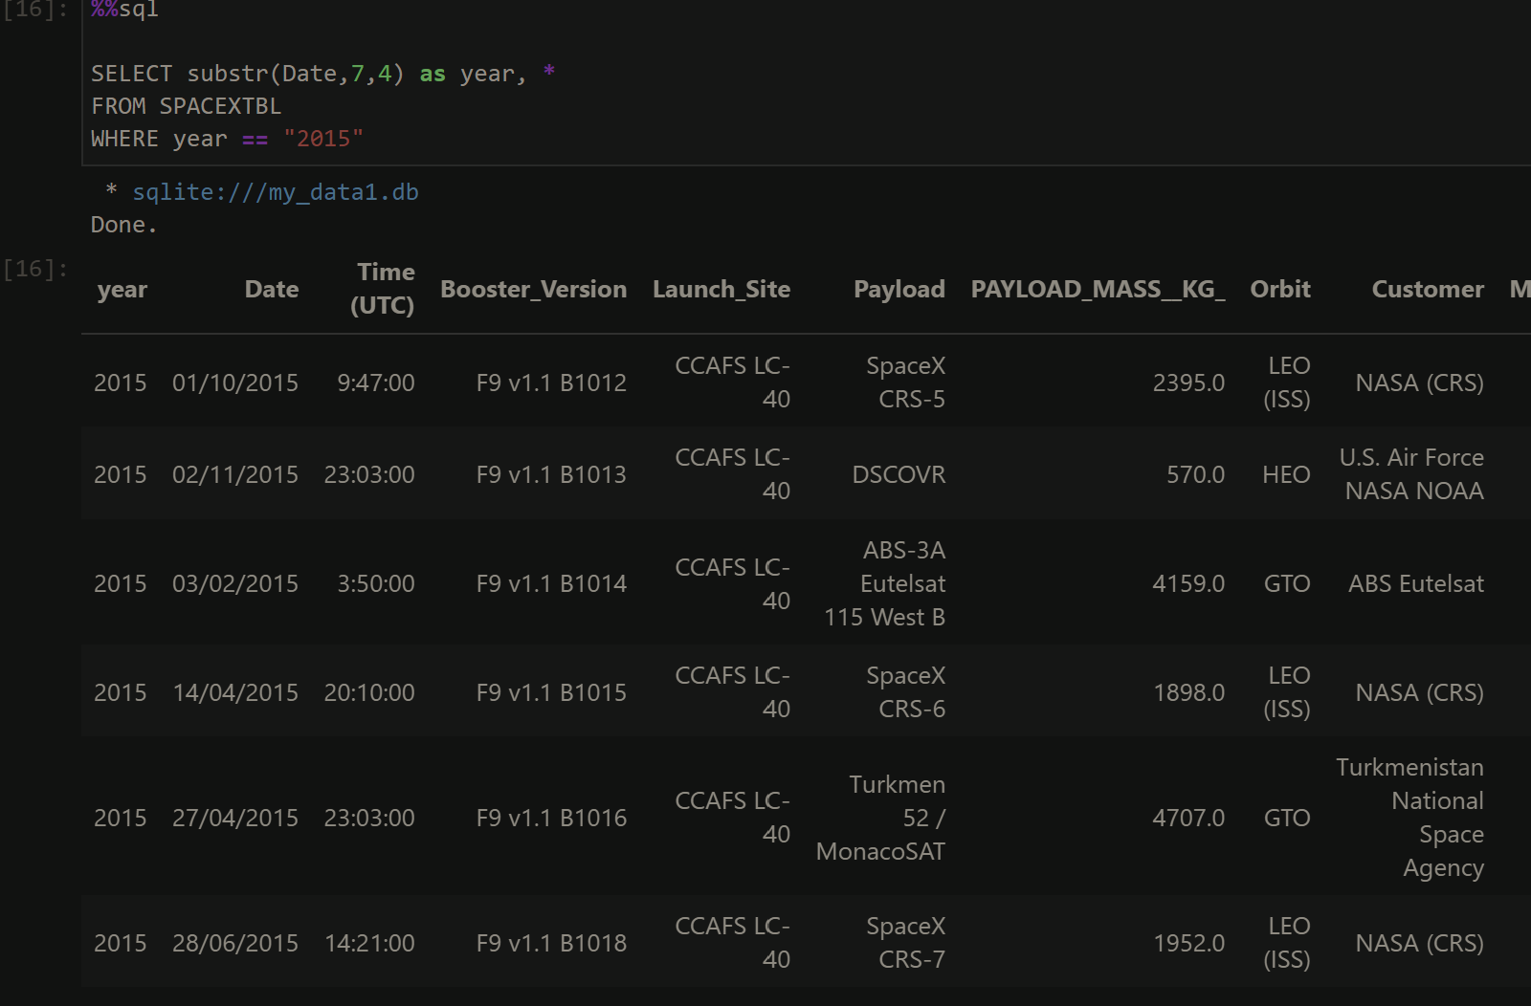
2015 Launch Records
List the failed landing_outcomes in drone ship, their booster versions, and launch site names for in year 2015
Present your query result with a short explanation here

Slide 30
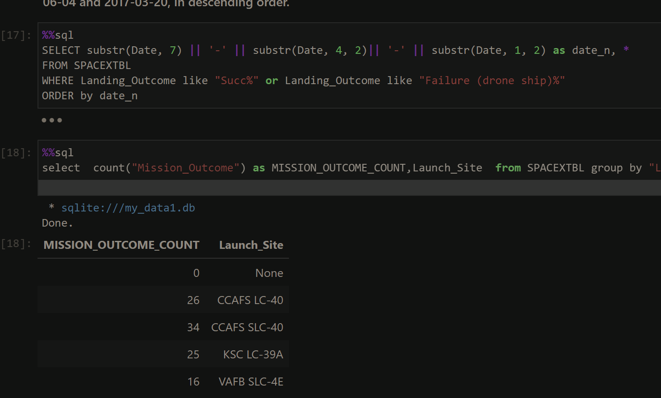
Rank Landing Outcomes Between 2010-06-04 and 2017-03-20
Rank the count of landing outcomes (such as Failure (drone ship) or Success (ground pad)) between the date 2010-06-04 and 2017-03-20, in descending order
Present your query result with a short explanation here

Slide 31

Section 3

Slide 32
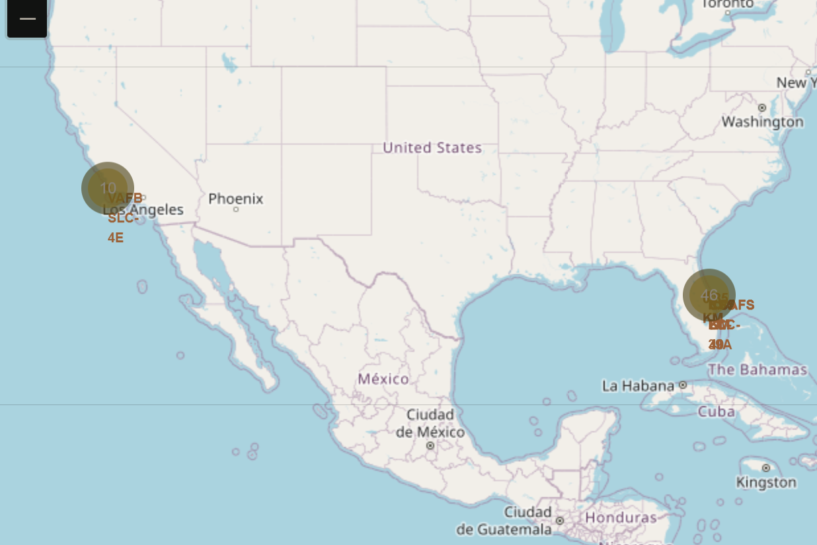
Launch site
Replace <Folium map screenshot 1> title with an appropriate title
Explore the generated folium map and make a proper screenshot to include all launch sites’ location markers on a global map
Explain the important elements and findings on the screenshot

Slide 33
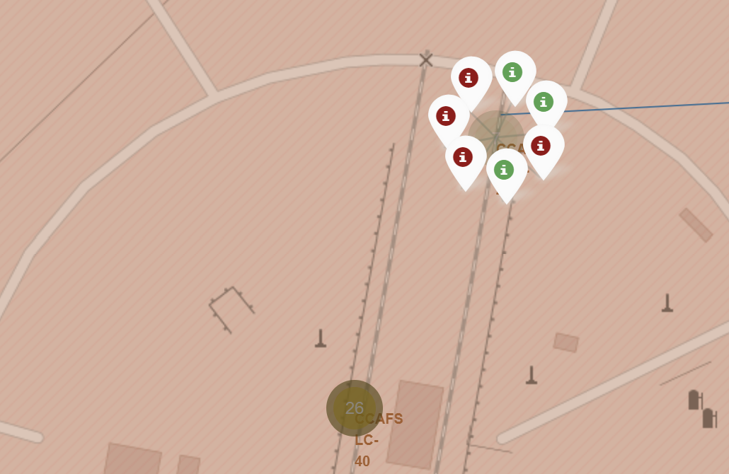
Launch outcome lable
Replace <Folium map screenshot 2> title with an appropriate title
Explore the folium map and make a proper screenshot to show the color-labeled launch outcomes on the map
Explain the important elements and findings on the screenshot

Slide 34
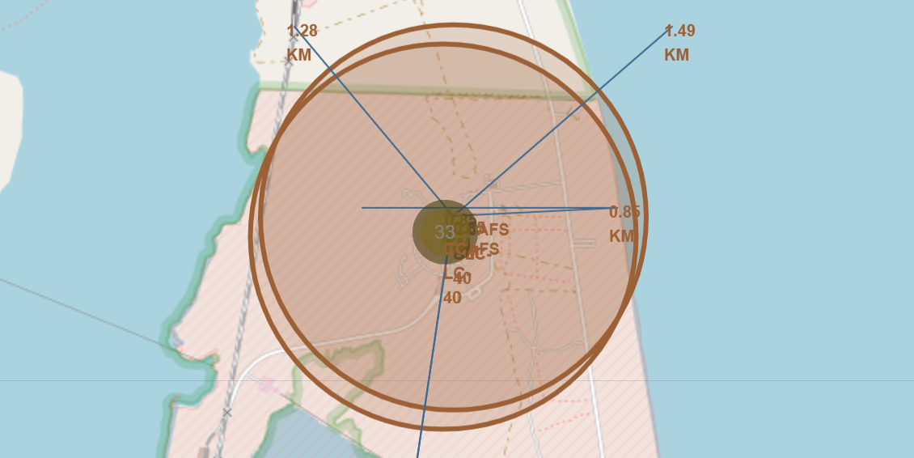
Distance to different objects
Replace <Folium map screenshot 3> title with an appropriate title
Explore the generated folium map and show the screenshot of a selected launch site to its proximities such as railway, highway, coastline, with distance calculated and displayed
Explain the important elements and findings on the screenshot

Slide 35

Section 4

Slide 36
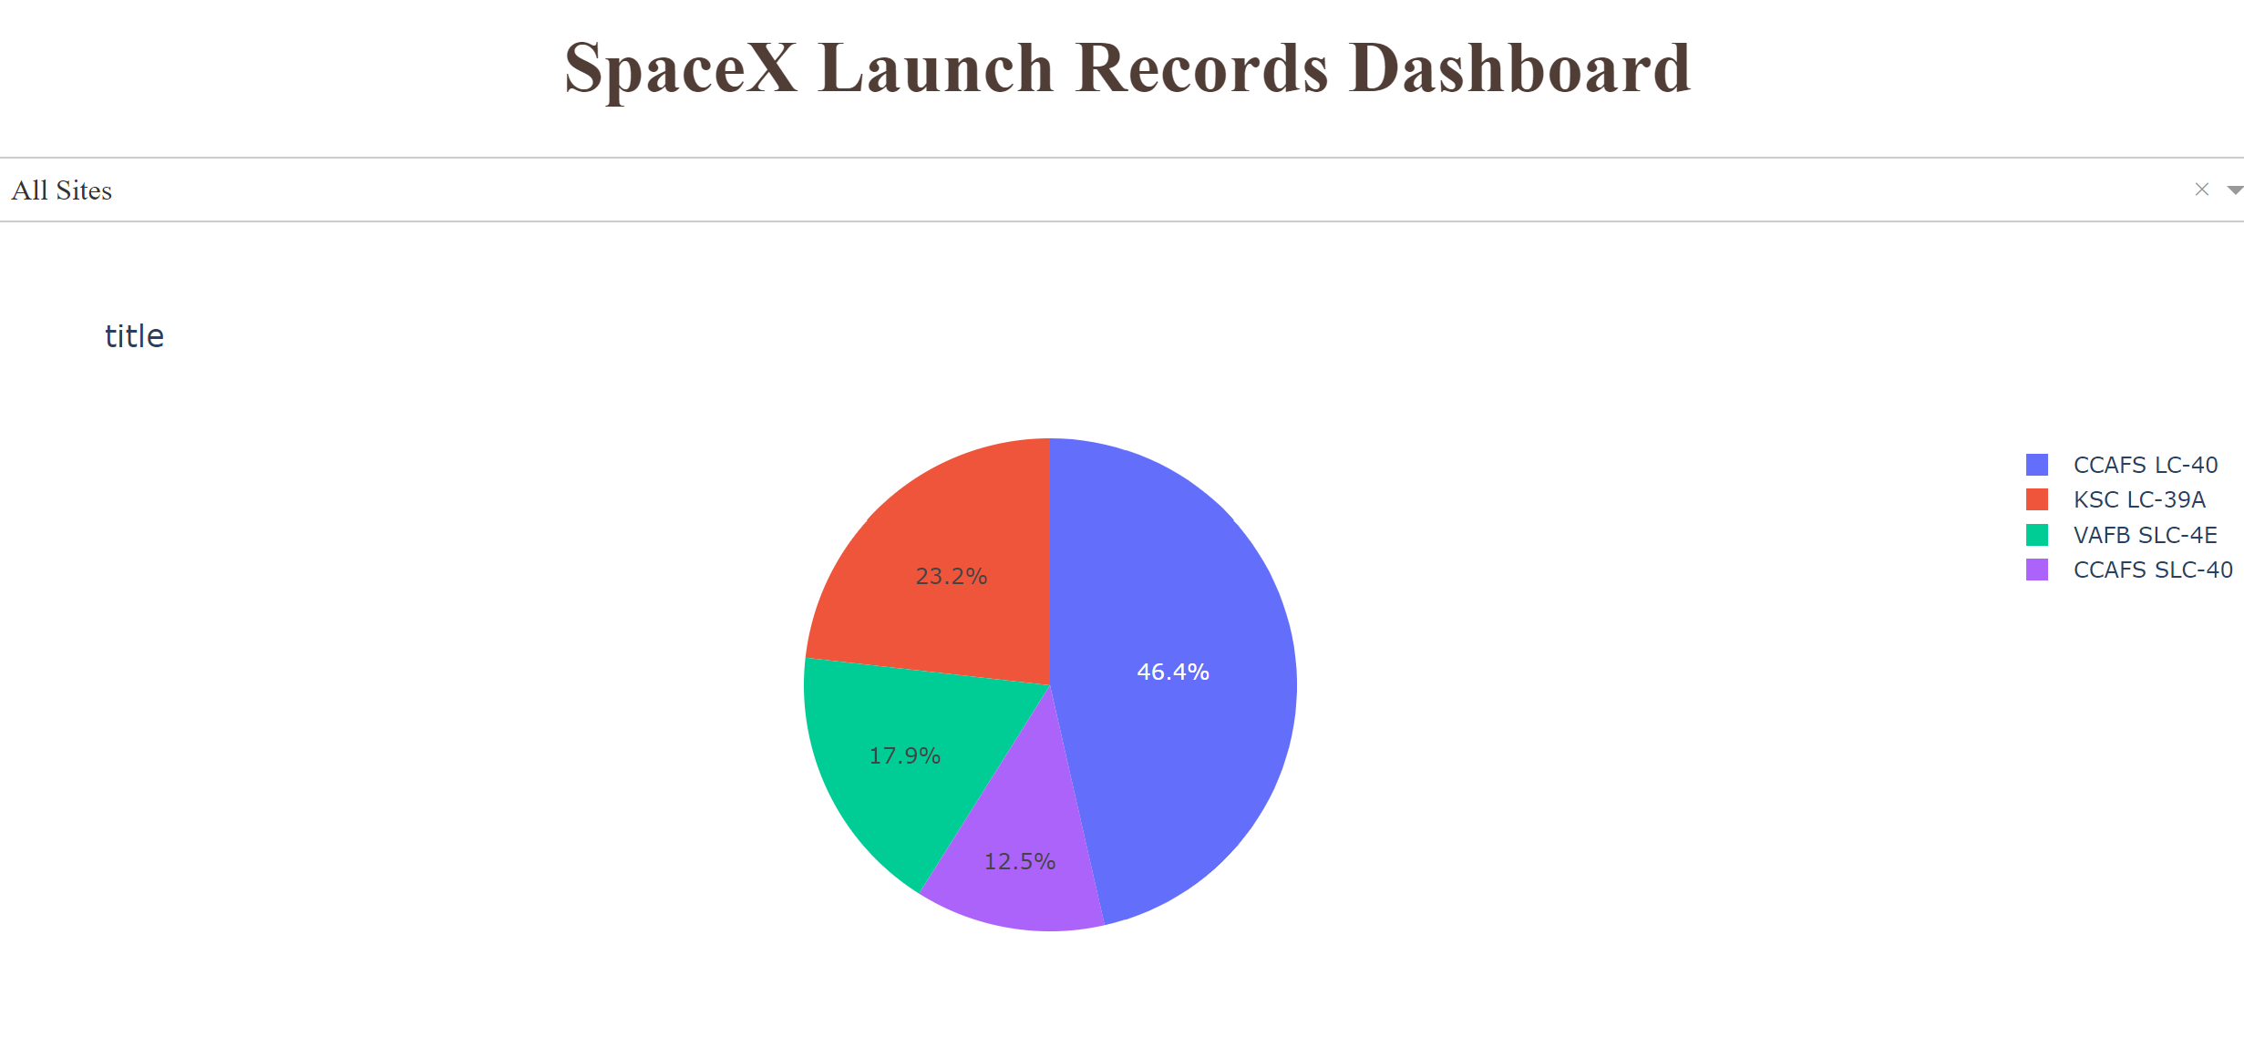
All Sites
Replace <Dashboard screenshot 1> title with an appropriate title
Show the screenshot of launch success count for all sites, in a piechart
Explain the important elements and findings on the screenshot
We see the percentage of successful launches

Slide 37
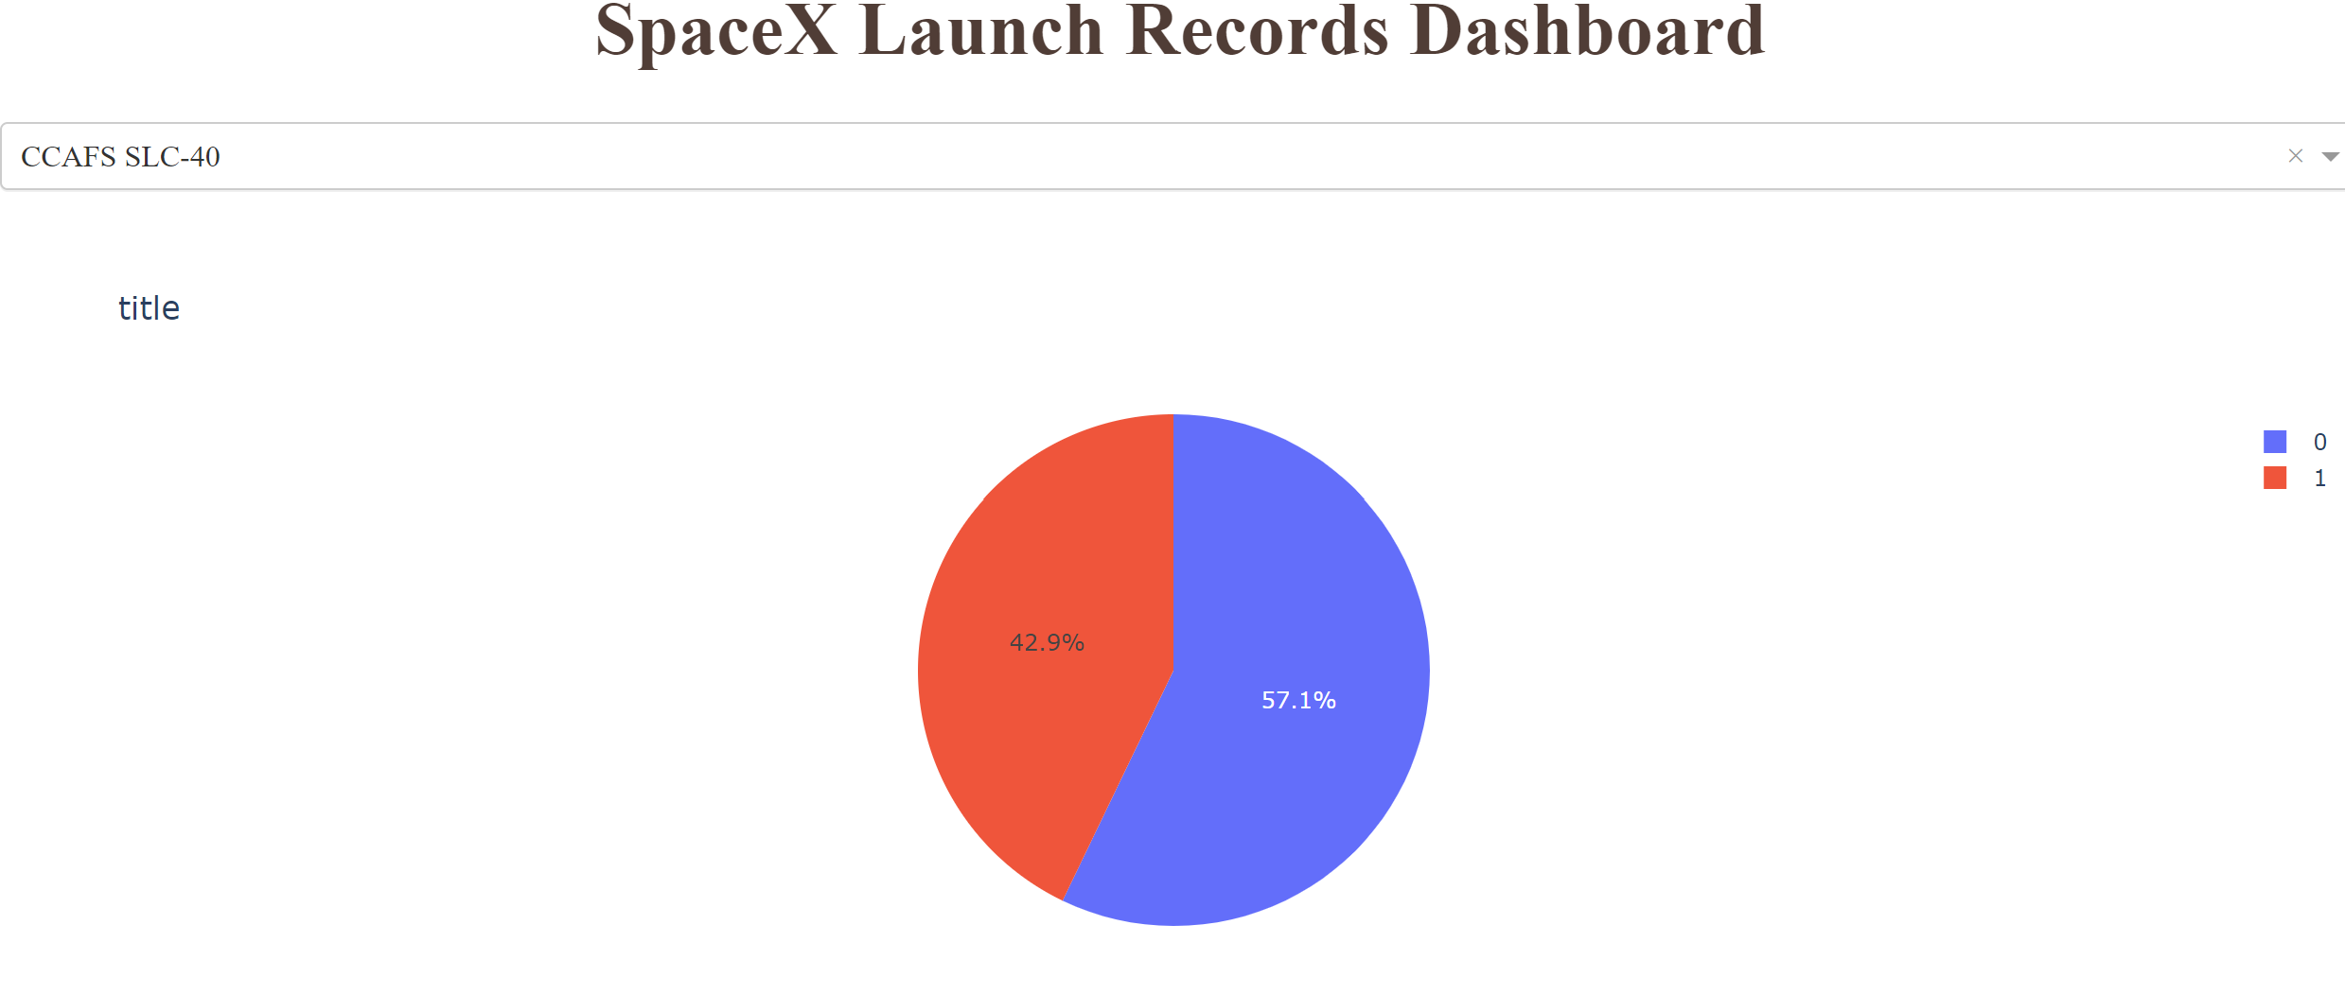
CCAFS SLC-40
Replace <Dashboard screenshot 2> title with an appropriate title
Show the screenshot of the piechart for the launch site with highest launch success ratio
Explain the important elements and findings on the screenshot
On CCAFS SLC-40 the most successful percentage of launches in relation to other places. however, this may be due to the total minority.

Slide 38
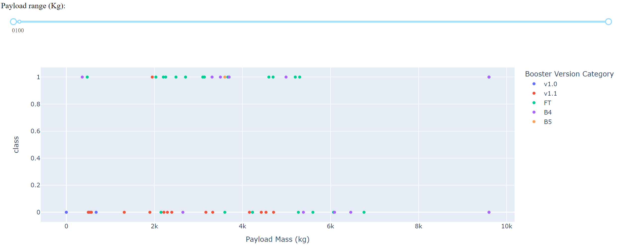
Payload vs Outcome
Replace <Dashboard screenshot 3> title with an appropriate title
Show screenshots of Payload vs. Launch Outcome scatter plot for all sites, with different payload selected in the range slider
Explain the important elements and findings on the screenshot, such as which payload range or booster version have the largest success rate, etc.
We can see that loading mass does not affect the outcome as much as the Booster Version type. The Booster Version brings more impact to the outcome

Slide 39

Section 5

Slide 40
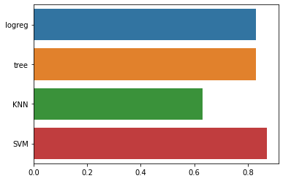
Classification Accuracy
Visualize the built model accuracy for all built classification models, in a bar chart
Find which model has the highest classification accuracy
Best accuracy : 0.87
SVM model

Slide 41
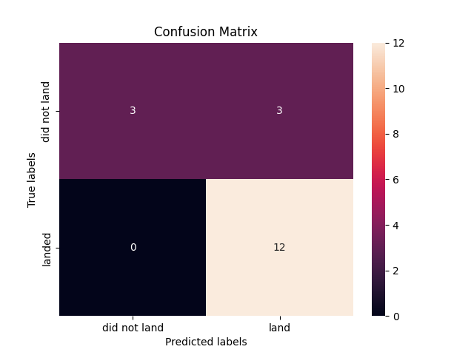
Confusion Matrix
Show the confusion matrix of the best performing model with an explanation

Slide 42
Conclusions
Point 1
Point 2
Point 3
Point 4
…

Slide 43
Appendix
Include any relevant assets like Python code snippets, SQL queries, charts, Notebook outputs, or data sets that you may have created during this project

Slide 44


